Slide 1
Introduction to Algorithms
Lecture 10

Slide 2
Today’s Topics
Flow networks
Residual networks
Augmenting paths
Max-flow Min-cut theorem
Ford-Fulkerson algorithm
Edmonds-Karp algorithm
Dinic algorithm
Applications

Slide 3
Flow networks
Model fundamental notion of material being transported across finite-capacity channels
Examples: water, current, data, etc.
Single source/sink, multi-source/sink, “multi-commodity”

Slide 4
Flow networks
2
Model as network (digraph G = (V, E)) with:
“source” node s and “sink” node t
Non-negative capacities c(u, v)
If (u, v) ∉ E, then c(u, v) = 0.
v
3
3
s
3
2
t
1
3
1
u
2
2
3

Slide 5
Flow
Flow on G is a function f: V × V → R satisfying
Capacity constraint: f(u,v) ≤ c(u,v) ∀u,v∈V.
Flow conservation:
Skew symmetry: f(u,v) = −f(v,u).
Flow value, is total flow out of source.
Goal: Finding Maximum Flow Value.

Slide 6
Example
2:2
v
1:3
2:3
s
1:3
0:2
t
0:1
1:1
1:3
2:2
u
1:2
2:3
|f| = 1 + 2 = 3

Slide 7
Flow Cancellation
Without loss of generality, positive flow goes either from u to v, or from v to u, but not both.
The capacity constraint and flow conservation are preserved by this transformation.
INTUITION: View flow as a rate, not a quantity.
v
v
Net flow from
u to v in both
case is 1.
2:3
1:2
1:3
0:2
u
u

Slide 8
Flow Decomposition
Any feasible flow f on a network G can be decomposed into at most m cycles and s-t paths (path flow).
a
12:12
b
11:16
15:20
s
0:10
1:4
t
4:9
7:7
8:13
c
d
4:4
11:14
Path flow: s→a→b→t, 11 s→c→d→t, 4 s→c→d→b→t, 4.
Cycle flow: a→b→c→a, 1 b→c→d→b, 3.

Slide 9
Residual Network
Residual Capacity of (u, v):
c_{f}(u,v) = c(u,v) – f(u,v) ≥ 0
Residual Network G_{f} is graph of edges with strictly positive residual capacity (that can support more flow)
Its edges come from G∪G^{T}, then |E_{f}| ≤ 2|E|.

Slide 10
Residual Network
G:
12:12
11:16
15:20
s
0:10
1:4
t
4:9
7:7
8:13
4:4
11:14
G_{f}:
12
5
5
4
15
s
11
11
3
t
5
7
5
8
11
4
3

Slide 11
Augmenting Path
An augmenting path is a path p from s to t in G_{f} (or “in G with respect to f”)
Increase flow in G by c_{f}(p) = min_{(u,v)∈p}c_{f}(u,v)
G_{f}:
12
5
5
4
15
s
11
11
3
t
5
7
5
8
11
4
3

Slide 12
Augmenting Path
G:
12:12
19:20
11:16
15:20
s
0:10
1:4
t
4:9
7:7
0:9
8:13
4:4
12:13
11:14

Slide 13
Augmenting Path
Suggests an algorithm (method):
Start with Zero Flow.
Find an augmenting path p in corresponding G_{f}.
Augment f by c_{f}(p) and loop.
(Ford-Fulkerson Algorithm)

Slide 14
Potential Problems
Convergence? Can it enter infinite loop? No, because we only accept augmenting paths.
Can we be guaranteed of finding an augmenting path if one exists? BFS finds all shortest paths from a source. If none are found to sink, then none exist.
Do we want a shortest path?
Do we want a longest path?
We really want a path of maximum capacity.
Global optimum? When no more augmenting paths can be found, how do we know we haven’t found a local optimum rather than the global optimum?

Slide 15
Properties of Flows
Lemma
For G=(V, E) a flow network and f a flow in G.
f(X, X) = 0 for all X ⊆ V.
f(X, Y) = − f(Y, X) for all X, Y ⊆ V.
f(X∪Y, Z) = f(X, Z) + f(Y, Z) for all X, Y, Z ⊆ V and X ∩ Y = Φ.
where f(X, Y) = Σ_{x∈X, y∈Y}f(x, y).

Slide 16
Illustrate Use
Flow is defined as net flow leaving source; show equal to that entering sink.
|f| ≡ f(s, V) = f(V, t).
Proof.
|f| ≡ f(s, V)
= f(V, V) – f(V–{s}, V)
= 0 + f(V, V–{s})
= f(V, t) + f(V, V – {s,t}) = f(V, t)

Slide 17
Illustrate Use
Slightly more intuitive proof:
|f| ≡ f(s, V) + f(V, t) – f(V, t)
= f(V, t) – (f(V, s) + f(V, t))
= f(V, t) – f(V, {s,t}) + f(V, V)
= f(V, t) + f(V, V – {s,t})
= f(V, t)

Slide 18
Cut
Cut is a partition of V into S and T = V – S with s ∈ S and t ∈ T.
Capacity of cut
Small capacity cuts serve as “barrier” to large flows.
A minimum cut of a network is that whose capacity is a minimum over all cuts in network.
Forward direction only

Slide 19
Cut
Lemma: Given any flow f, |f| = f(S, T) for and any (S, T).
Proof: f(S, T) = f(S, V) – f(S, S)
= f(s, V) + f(S – s, V)
= f(s, V) = |f|
This is like another conservation of flow idea
by definition for flow out of source (S={s})
already proven for flow into sink (T={t})
have proven for any partition (cut) dividing s, t

Slide 20
Cut
Corollary: The value of any flow is bounded above by the capacity of any cut.
f(S, T) ≤ c(S, T) for all cuts (S, T)
Proof:

Slide 21
The Max-Flow Min-Cut Theorems
The following are equivalent:
f is a maximum flow in G.
The residual network G_{f} contains no augmenting paths.
|f| = c(S, T) for some cut (S, T) of G.
Proof sketch
1⇒2 Augmenting path would allow flow in G to be increased above f, contradicting its being a maximum flow .

Slide 22
The Max-Flow Min-Cut Theorems
3⇒1 By corollary, |f| is bounded from above by the capacity of any cut, so |f| = c(S,T) means it can’t be increased.
2⇒3 G_{f} has no augmenting path. Let S = {u∈V:
∃path from s to u in G_{f}} and T = V – S.
s∈S and t ∈ T (otherwise would be augmenting path).
(S, T) is a cut.
c_{f}(u, v)=0 for u∈S, v∈T (otherwise v would be in S).

Slide 23
The Max-Flow Min-Cut Theorems
∴ f(u,v)=c(u,v), since c_{f}(u, v) = c(u,v) – f(u,v).
|f| = f(S, T) = c(S, T).
summation
path in G_{f}
s
u
v
S
T

Slide 24
Ford-Fulkerson Algorithm
f(u, v) ← 0 ∀u, v
while ∃ augmenting path p in G_{f}
do augment f by c_{f}(p)
Thus, the Ford-Fulkerson algorithm is guaranteed to result in successive improvements. When no more improvements are possible, the maximum flow has been found.

Slide 25
Ford-Fulkerson Algorithm
Notice: F-F doesn’t specify which path!
Analysis (with Integer Capacities):
Cost per path: O(E) using DFS or BFS
Thus run time is O(E |f*|), where f* is max flow
This is not polynomial in |V|, |E|!
Integrality property: If all capacities c_{e} are integer, then there is an integral maximum flow f.

Slide 26
Possible Efficiency Problem
10⁹
10⁹
10⁹-1
10⁹
s
1
t
s
1
1
t
1
10⁹
10⁹
10⁹
10⁹ -1
10⁹-1
10⁹-1
1
s
1
1
t
1
2*10⁹ iterations!
1
10⁹-1
10⁹ -1

Slide 27
Edmonds-Karp Algorithm 1
Modify Dijkstra’s algorithm to find an augmenting path of largest capacity. (the maximum bottleneck path)
Claim 1. In a graph with maximum s-t flow F, there must exist a path from s to t with capacity at least F/m.
Claim 2. Edmonds-Karp #1 makes at most O(m log F) iterations.
Running time: O(m² log n log F).

Slide 28
Edmonds-Karp Algorithm 2
Use BFS to find breadth-first augmenting path
Time to find an augmenting path Θ(V + E) ⇒ Θ(E) if all vertices reachable from source.
Claim: number of augmentations limited to Θ(VE)
⇒ Running time Θ(VE²).

Slide 29
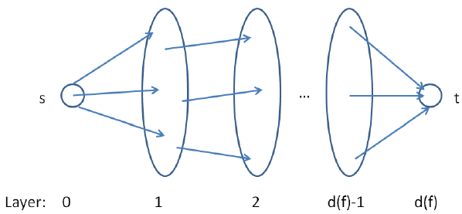
Level Graph
Definition. The level graph L_{G} of G is the directed breath-first search graph with root s with cross edges and back edges deleted. The level of a vertex u is the length of a shortest path from s to u in G.

Slide 30
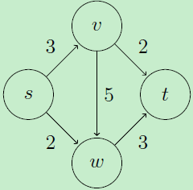
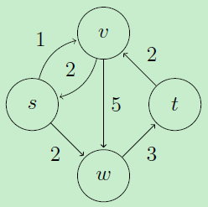
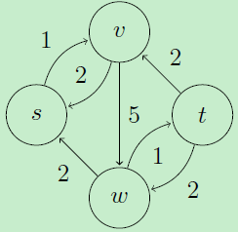
Level Graph - Example
V₀ = {s}
V₁ = {v, w}
V₂ = {t}
V₀ = {s}
V₁ = {v, w}
V₂ = {t}
V₀ = {s}
V₁ = {v}
V₂ = {w}
V₃ = {t}

Slide 31
Edmonds-Karp #2 Analysis
Monotonicity Lemma
Let δ(v) = δ_{f}(s, v)
= B-F distance from s to v in G_{f}.
Then δ(v) increases monotonically during E-K.
Suppose algorithm augments f to produce f’.
Prove by δ’(v) ≥ δ(v) induction on δ(v).

Slide 32
Monotonicity Lemma
Base: δ’(s) = δ(s) = 0
Inductive Step: Consider BF-path s→…u → v in G_{f’}
δ’(v) = δ’(u) + 1
(u, v) ∈ E_{f’} [What about E_{f}?]
Case 1: (u, v) ∈ E_{f}
Then δ(v) ≤ δ(u) + 1 [triangle ineq.]
≤ δ’(u) + 1 [induction]
= δ’(v) [BF path]

Slide 33
Monotonicity Lemma
Case 2: (u, v) ∉ E_{f}
Augmenting path must have included (v,u)
s→…v → u →… → t
Then δ(v) = δ(u) − 1 [BF path]
≤ δ’(u) − 1 [induction]
= δ’(v) – 2 [BF path]
< δ’(v)

Slide 34
Edmonds-Karp # 2 Analysis
Theorem: #Augmenting Steps in E-K algorithm is Θ(VE).
Proof: Let p be an augmenting path.
Residual capacity of some edge (u,v) ∈ p is c_{f}(p) = c_{f}(u, v) ⇒ (u,v) called critical
Augmentation removes (u,v) from critical path (for now, saturated)
Must wait until (v,u) augmented before re-appears.

Slide 35
Edmonds-Karp # 2 Analysis
Before p augmented (u,v): δ(v)=δ(u)+1 (p: BF path)
Before augmenting (v,u) later:
δ’(u) = δ’(v) + 1
≥ δ(v) + 1
≥ δ(u) + 2
⇒ δ(u) increases ≥ 2 between twice when (u,v) is critical. Each δ(u) starts ≥ 0, never decreases, and remains ≤ |V| − 1 until unreachable.
⇒(u, v) is critical at most Θ(V) times
Θ(E) edges in G_{f} ⇒ Θ(VE) augmentation

Slide 36
Blocking Flow
A flow f in G is blocking if every s-t path in G, the original graph, has some edge saturated.
Every maximum flow is obviously also a blocking flow.
Is every blocking flow a maximum flow? No.
How to efficiently find a blocking flow?

Slide 37
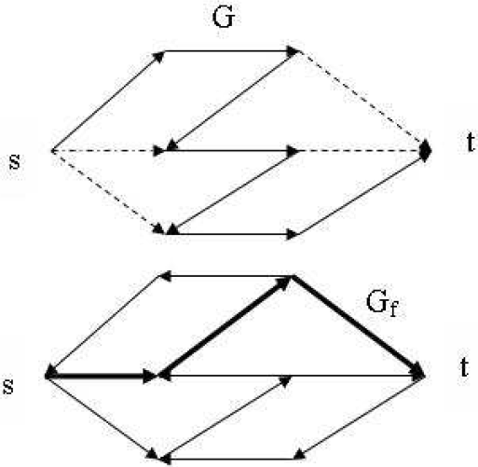
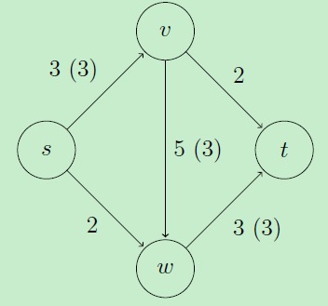
Blocking Flow

Slide 38
Dinic’s Algorithm – One Phase
Traverse the level graph from source to sink in a depth-first fashion.
Advance whenever possible and keep track of the path from s to the current vertex.
If we get all the way to t, we have found an augmenting path, and we augment by that path.
If we get to a vertex with no outgoing edges, we delete the vertex and retreat.

Slide 39
Dinic’s Algorithm - Initialize
Initialize.
Construct a new level graph L_{G}.
Set u = s and p = [s].
Go to Advance.

Slide 40
Dinic’s Algorithm - Advance
Advance.
If there is no edge out of u, go to Retreat.
Otherwise, let (u,v) be such an edge.
Set p = p||[v] and u = v.
If v ≠ t then go to Advance.
If v = t then go to Augment.

Slide 41
Dinic’s Algorithm - Retreat
Retreat.
If u = s then halt.
Otherwise, delete u and all adjacent edges from L_{G} and remove u from the end of p.
Set u = the last vertex on p.
Go to Advance.

Slide 42
Dinic’s Algorithm - Augment
Augment.
Let Δ be the bottleneck capacity along p.
Augment by the path flow along p of value Δ, adjusting residual capacities along p.
Delete newly saturated edges.
Set u = the last vertex on the path p reachable from s along unsaturated edges of p.
Set p = the portion of p up to and including u.
Go to Advance.

Slide 43
Time Complexity of Dinic’s Alg
Initialize: O(m) per phase. (BFS)
Advance: O(mn). (at most n advances before an augment or retreat)
Retreat: O(m + n). (at most n retreats)
Augment: O(mn). (at most m augments)
Each phase requires O(mn) time.
Total running time: O(mn²).

Slide 44
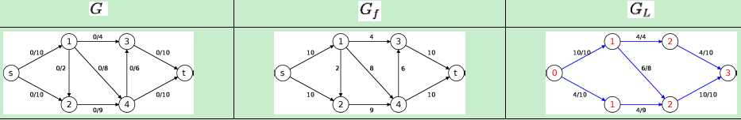
Dinic’s Algorithm – Example
The blocking flow consists of
{s, 1, 3, t} with 4 units of flow,
{s, 1, 4, t} with 6 units of flow, and
{s, 2, 4, t} with 4 units of flow.
The blocking flow is of 14 units and the value of flow is 14.
Each augmenting path in the blocking flow has 3 edges.

Slide 45
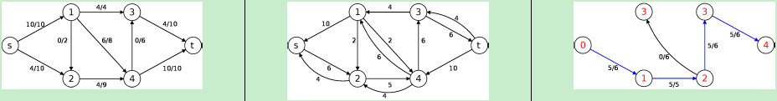
Dinic’s Algorithm – Example
The blocking flow consists of
{s, 2, 4, 3, t} with 5 units of flow.
The blocking flow is of 5 units and the value of flow is |f| = 14 + 5 = 19.
Each augmenting path has 4 edges.

Slide 46
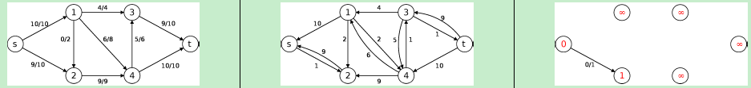
Dinic’s Algorithm – Example
Since t cannot be reached in G_{f}. The algorithm terminates and returns a flow with maximum value of 19.
Note that in each blocking flow, the number of edges in the augmenting path increases by at least 1.

Slide 47
Dinic’s Algorithm Analysis
Theorem 1 Blocking flows in acyclic graphs can be found in O(mn) time, but if fancy data structures are used, then they can be found in O(mlog n) time.
Lemma 2 The distance to the sink d_{t} strictly increases in each iteration of the algorithm.
Theorem 3 Dinic's algorithm can be implemented in O(mn²) time (Dinic 1970), or O(mnlog n) time (Sleater, Tarjan 1980).

Slide 48
Unit Capacity Graphs
Definition. A unit capacity graph has c_{e} for all edges e ∈ E.
Lemma 1. If graph is unit capacity, then Dinic’s algorithm takes O(min(m^{1/2}, 2n^{2/3})) iteration.
Lemma 2. We can find a blocking flow in unit capacity graph in O(m) time.
Theorem. In unit capacity graphs, the maximum flow can be found in O(m⋅ min(m^{1/2}, 2n^{2/3})) time.

Slide 49
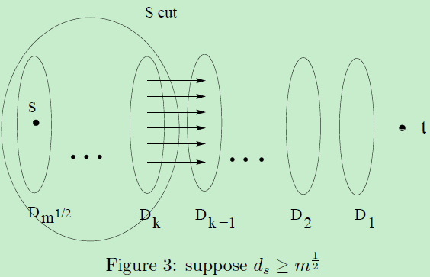
Proof of Lemma 1
Case 1:

Slide 50
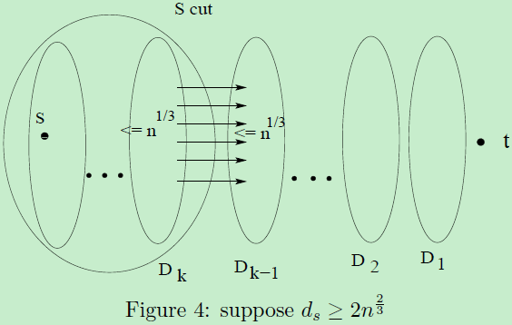
Proof of Lemma 1
Case 2:

Slide 51
Edge Disjoint Paths
Disjoint path problem. Given a digraph G = (V, E) and two nodes s and t, find the max number of edge-disjoint s-t paths.
Def. Two paths are edge-disjoint if they have no edge in common.
Ex: communication networks.

Slide 52
Edge Disjoint Paths
Disjoint path problem. Given a digraph G = (V, E) and two nodes s and t, find the max number of edge-disjoint s-t paths.
Def. Two paths are edge-disjoint if they have no edge in common.
Ex: communication networks.

Slide 53
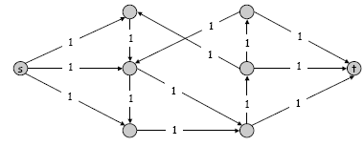
Edge Disjoint Paths
Max flow formulation: assign unit capacity to every edge.
Theorem. Max number edge-disjoint s-t paths equals max flow value.
Pf. →
Suppose there are k edge-disjoint paths P₁, . . . , P_{k}.
Set f(e) = 1 if e participates in some path P_{i}; else set f(e) = 0.
Since paths are edge-disjoint, f is a flow of value k.

Slide 54
Edge Disjoint Paths
Max flow formulation: assign unit capacity to every edge.
Theorem. Max number edge-disjoint s-t paths equals max flow value.
Pf. ←
Suppose max flow value is k.
Integrality theorem → there exists 0-1 flow f of value k.
Consider edge (s, u) with f(s, u) = 1.
by conservation, there exists an edge (u, v) with f(u, v) = 1
continue until reach t, always choosing a new edge
Produces k (not necessarily simple) edge-disjoint paths.

Slide 55
Matching
Input: undirected graph G = (V, E).
M ⊆ E is a matching if each node appears in at most one edge in M.
Max matching: find a max cardinality matching.

Slide 56
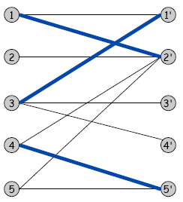
Bipartite Matching
Input: undirected graph G = (L ∪ R, E).
M ⊆ E is a matching if each node appears in at most one edge in M.
Max matching: find a max cardinality matching.
L
R

Slide 57
Bipartite Matching
Input: undirected graph G = (L ∪ R, E).
M ⊆ E is a matching if each node appears in at most one edge in M.
Max matching: find a max cardinality matching.
Max matching
L
R

Slide 58
Bipartite Matching
Max flow formulation.
Create digraph G' = (L ∪ R ∪{s, t}, E' ).
Direct all edges from L to R, and assign infinite (or unit) capacity.
Add source s, and unit capacity edges from s to each node in L.
Add sink t, and unit capacity edges from each node in R to t.

Slide 59
Bipartite Matching: Proof of Correctness
Theorem. Max cardinality matching in G = value of max flow in G'.
Pf. →
Given max matching M of cardinality k.
Consider flow f that sends 1 unit along each of k paths.
f is a flow, and has cardinality k.

Slide 60
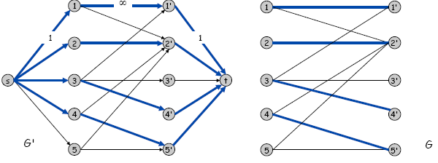
Bipartite Matching: Proof of Correctness
Theorem. Max cardinality matching in G = value of max flow in G'.
Pf. ←
Let f be a max flow in G' of value k.
Integrality theorem → k is integral and can assume f is 0-1.
Consider M = set of edges from L to R with f(e) = 1.
each node in L and R participates in at most one edge in M
|M| = k: consider cut (L ∪ s, R ∪ t)

Slide 61
Bipartite Matching: Running Time
Which max flow algorithm to use for bipartite matching?
Generic augmenting path: O(m|f*|) = O(mn).
Capacity scaling: O(m² logC ) = O(m²).
Shortest augmenting path: O(mn^{1/2}).

Slide 62
Application: Image segmentation
Image segmentation.
Central problem in image processing.
Divide image into coherent regions.
Ex: Three people standing in front of complex background scene.
Identify each person as a coherent object.

Slide 63
Image segmentation
Foreground / background segmentation.
Label each pixel in picture as belonging to foreground or background.
V = set of pixels, E = pairs of neighboring pixels.
a_{i} ≥ 0 is likelihood pixel i in foreground.
b_{i} ≥ 0 is likelihood pixel i in background.
p_{ij} ≥ 0 is separation penalty for labeling one of i and j as foreground, and the other as background.

Slide 64
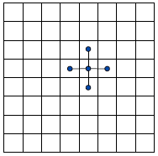
Image segmentation
Goals.
Accuracy: if a_{i} > b_{i} in isolation, prefer to label i in foreground.
Smoothness: if many neighbors of i are labeled foreground, we should be inclined to label i as foreground.
Find partition (A, B) that maximizes:
foreground
background

Slide 65
Image segmentation
Formulate as min cut problem.
Maximization.
No source or sink.
Undirected graph.
Turn into minimization problem.
Maximizing:

Slide 66
Image segmentation
Is equivalent to minimizing
or alternatively

Slide 67
Image segmentation
Formulate as min cut problem. G' = (V', E').
Add source to correspond to foreground; add sink to correspond to background
Use two anti-parallel edges instead of undirected edge.

Slide 68

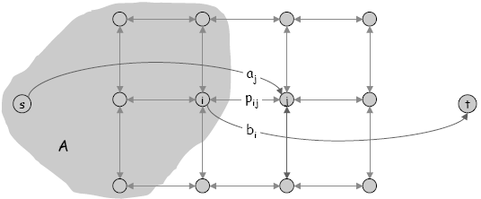
Image segmentation
Consider min cut (A, B) in G'.
A = foreground.
Precisely the quantity we want to minimize.

Slide 69
作业：26.1-4, 26.2-3, 26-5
预习：29.1-29.2, 29.4

